Slide 1
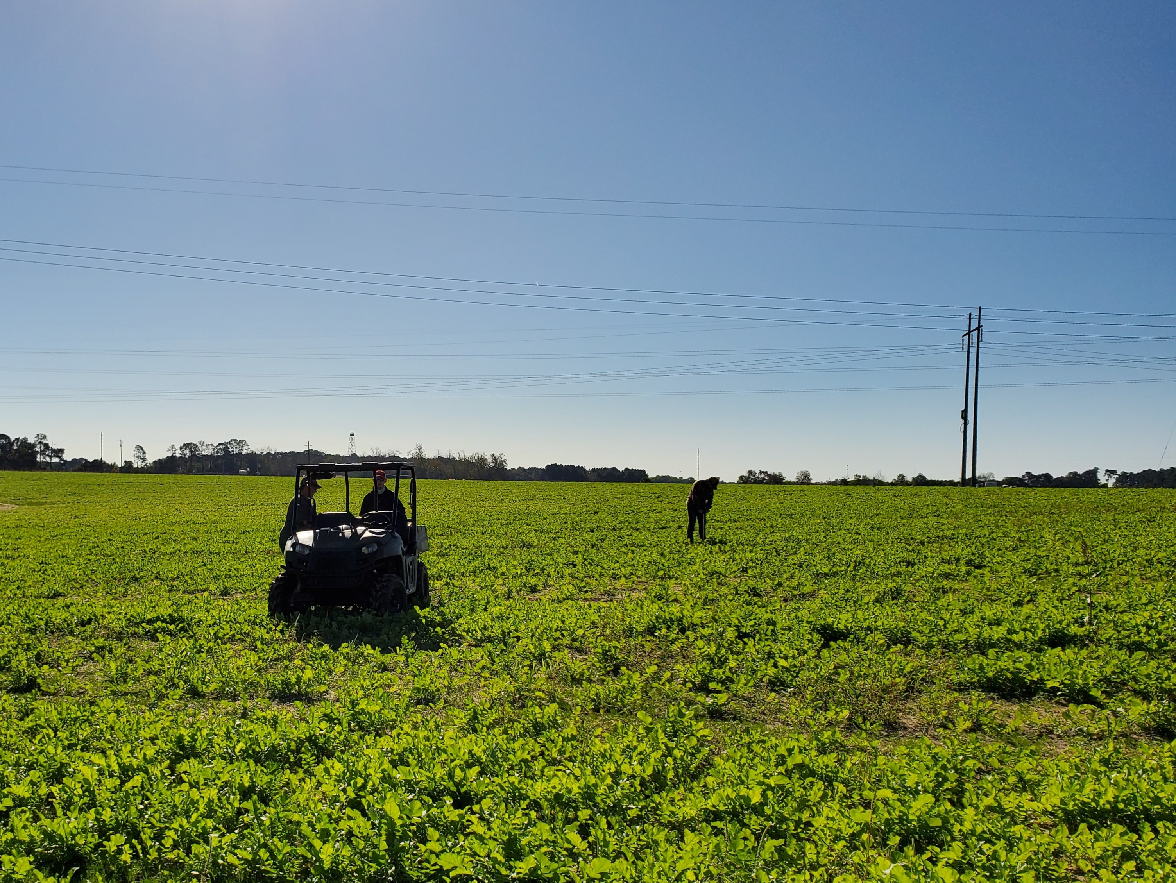



Impact of Soil Sampling Strategy on Application Accuracy and Economics of Site-Specific Nutrient Management in Cotton
2023 MASTPAWG Conference
Jay Lessl - Ag Services Laboratory
Matt Tucker – Crop & Soil Science
Dr. Simer Virk – Crop & Soil Science
University of Georgia
@PrecAgEngineer

Slide 2
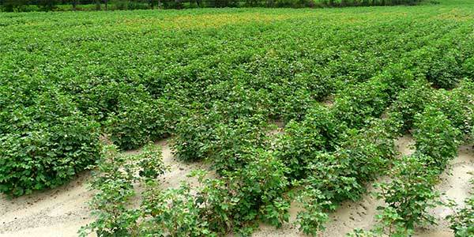
Cotton Fertilization
  General Recommendations:
  Soil pH: 6.0 – 6.3
  P and K: upper to medium range
  50-80 lbs/A
  Precision soil sampling to guide Variable-rate fertilizer applications

Slide 3
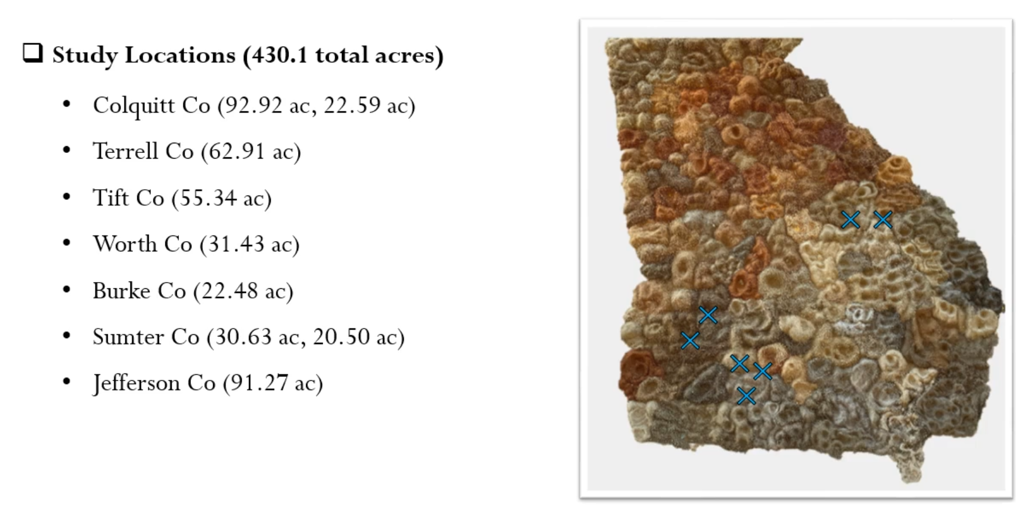
Study Design

Slide 4
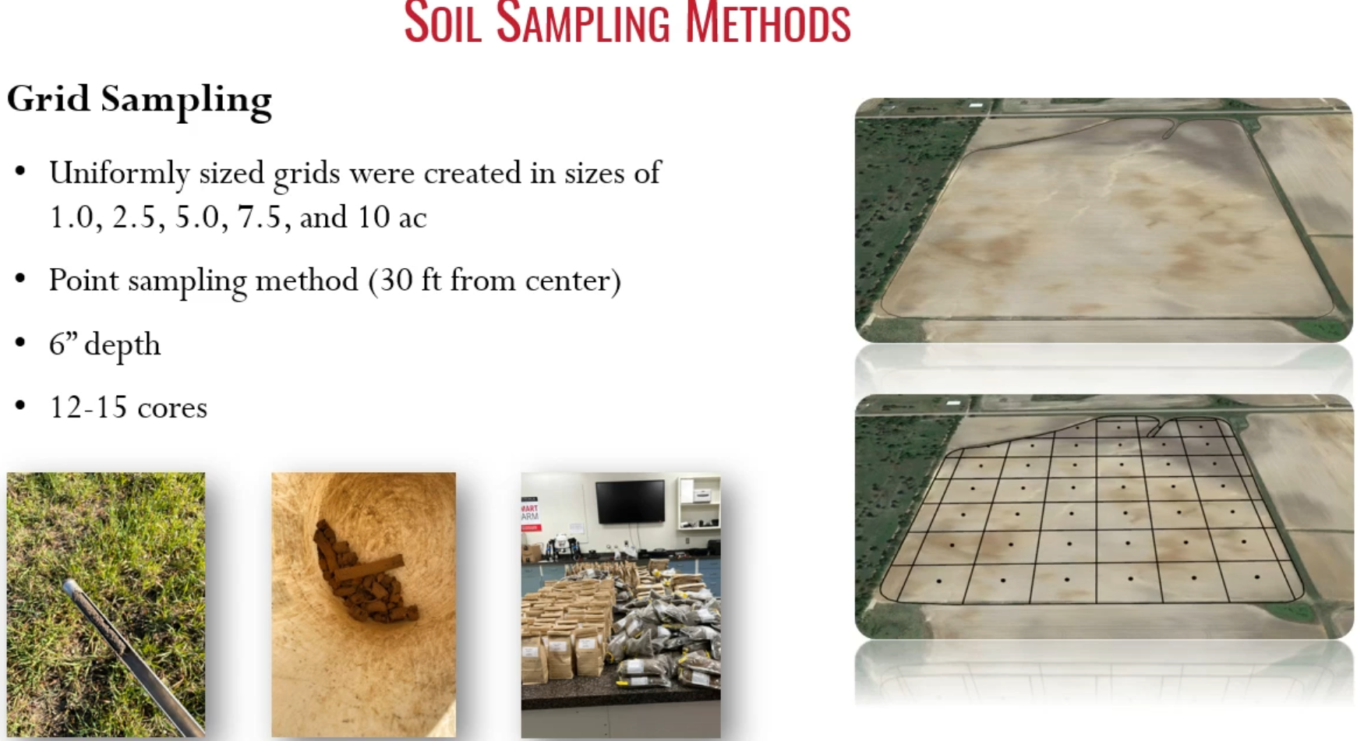
Soil Sampling Methods

Slide 5
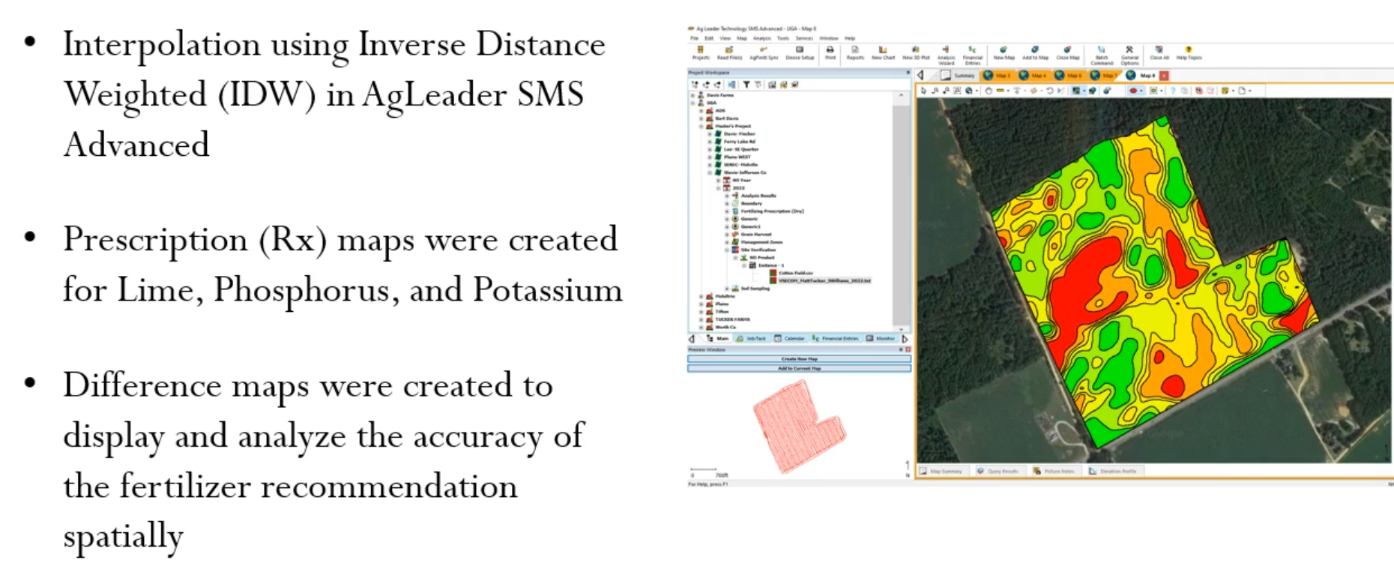
Data Analysis and GIS

Slide 6
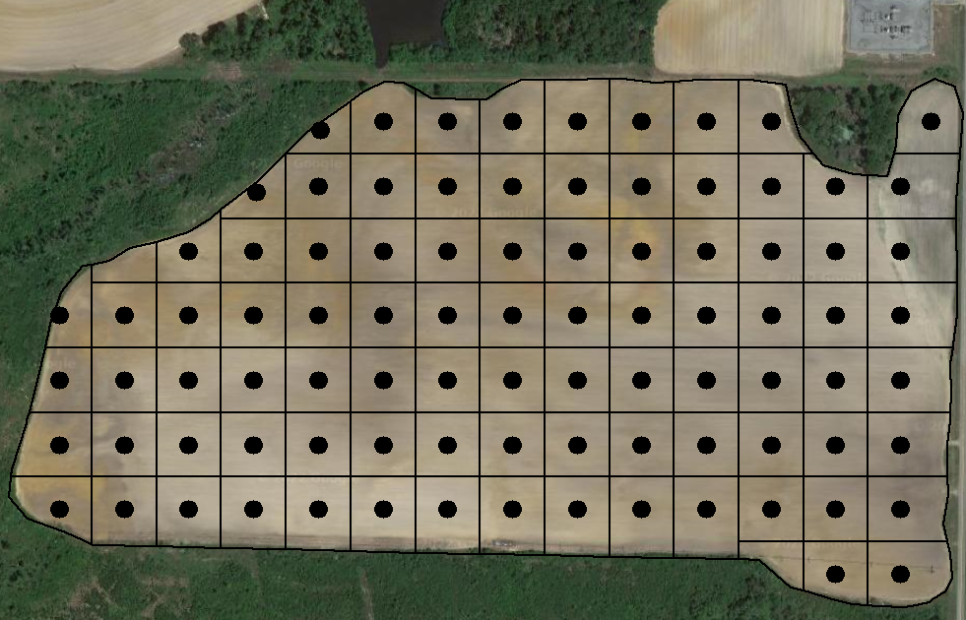
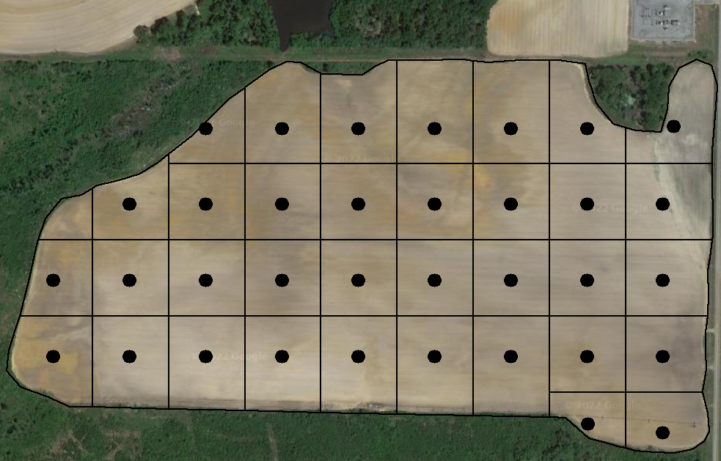
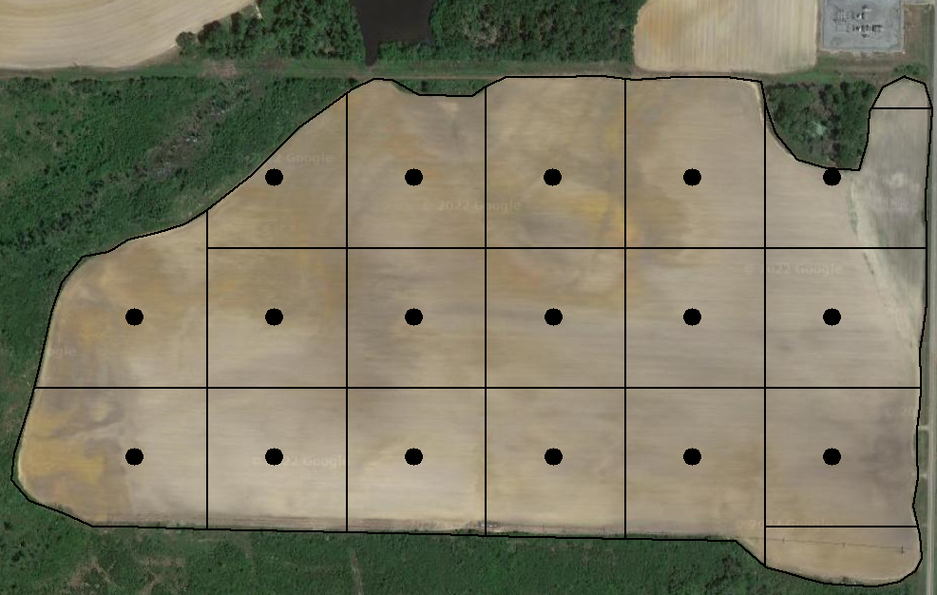


Optimal Grid Size for Soil Sampling?
Grid Size (ac) | #samples | Soil Sampling/ Labor Costs ($) | Sample Analysis Costs ($) | Total Cost ($)
1.0 | 92 | 460 | 552 | 1012
2.5 | 35 | 414 | 210 | 624
5.0 | 17 | 368 | 102 | 470
7.5 | 13 | 368 | 78 | 446
10.0 | 8 | 368 | 48 | 416
1.0 ac
2.5 ac
5.0 ac
7.5 ac
10.0 ac

Slide 7
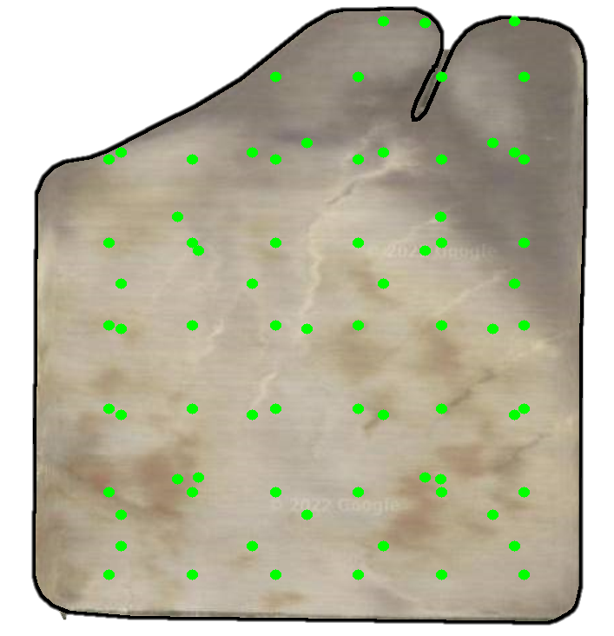
“Actual” Nutrient Variability
Soil sampling points from all grid sizes (1.0, 2.5, 5.0, 7.5 and 10.0 ac) were combined plus additional soil samples taken as required.
This high-density sampling map
(2-4 samples/ac) was assumed to represent actual nutrient variability.

Slide 8

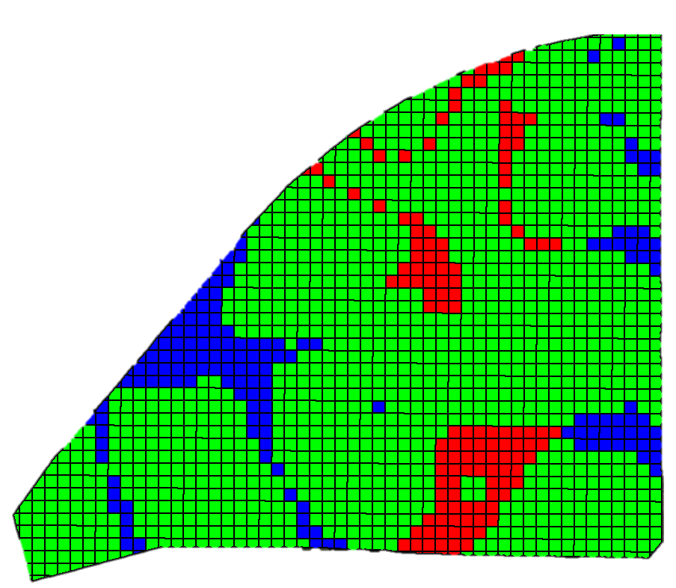
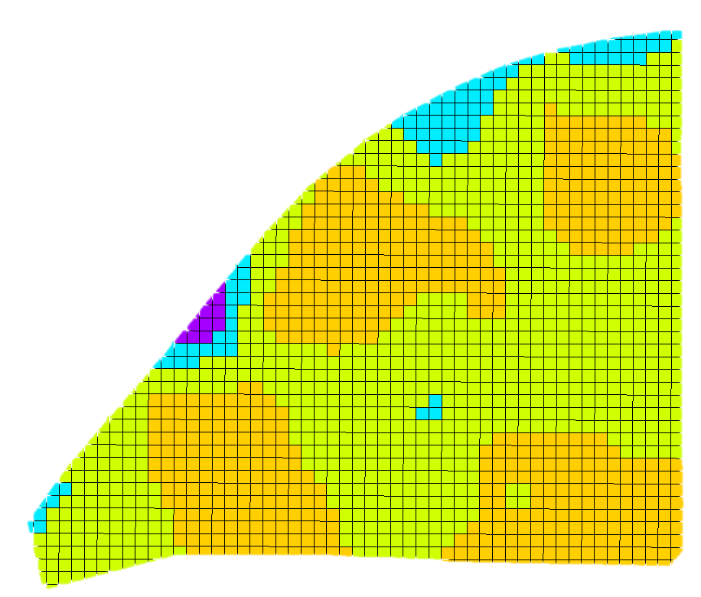
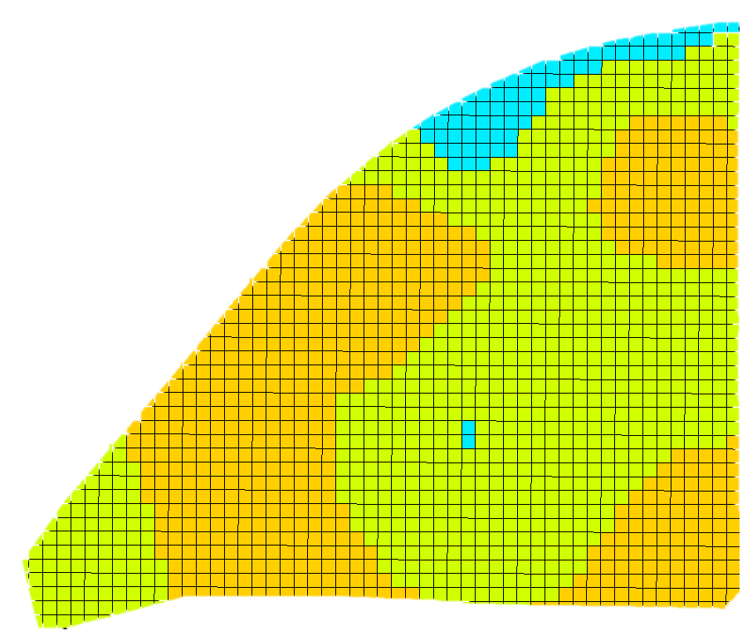
Spatial Application Accuracy
On-Target
Prescription Map
(All points representing most accurate nutrient variability)
Prescription Map (2.5 ac grid sampling)
Map showing on-target, under- and over-application areas
Under Applied
Over Applied
Notes:
The soil test results will be imported into AgLeader SMS Advanced.
Interpolated maps of soil nutrient values were created using the Inverse Distance Weighted (IDW) method.

Slide 9
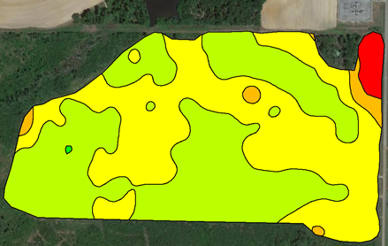
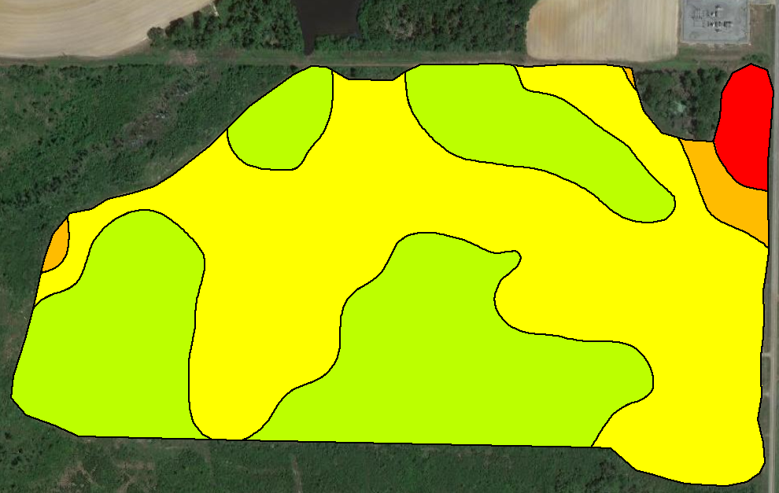
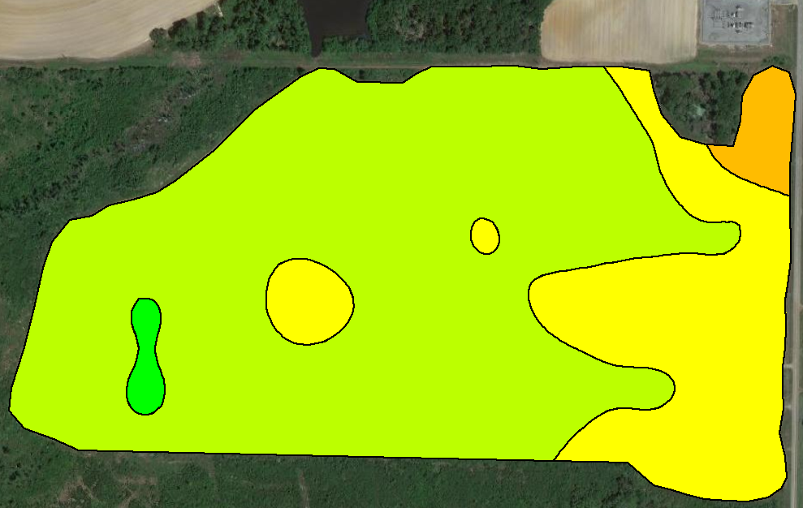
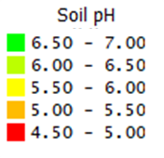
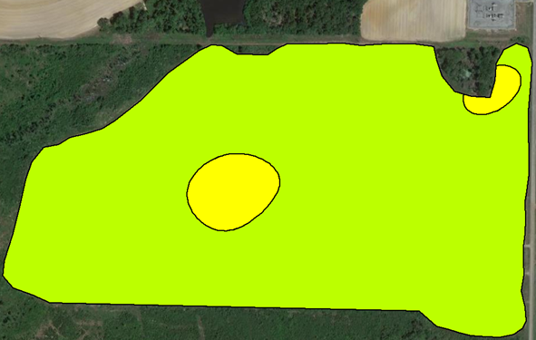
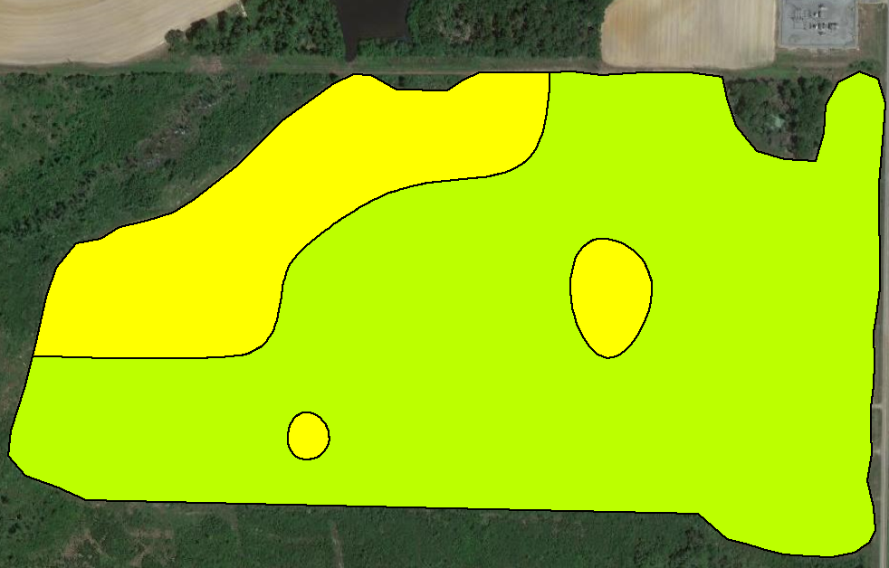
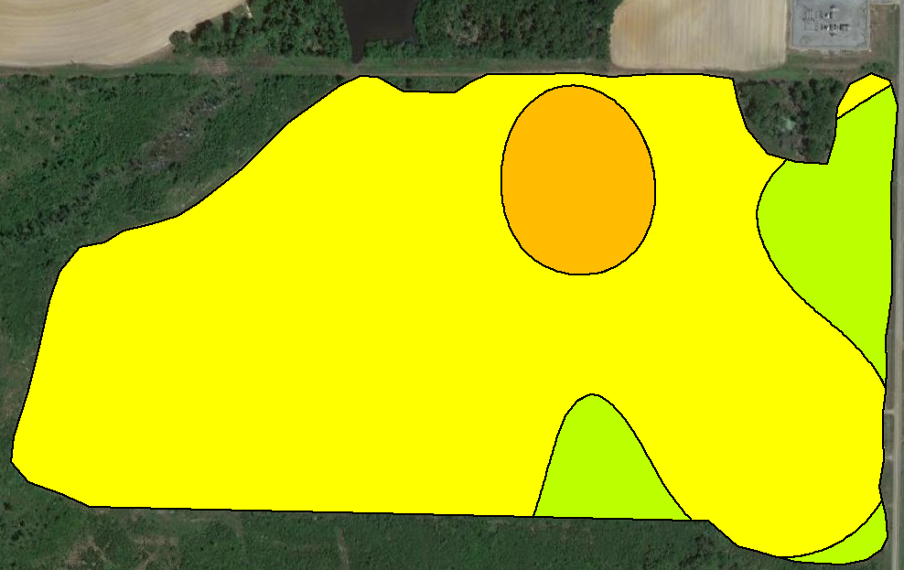
1 ac
(92 samples)
2.5 ac
(35 samples)
All 163 Samples
5 ac
(17 samples)
10 ac
(8 samples)
7.5 ac
(13 samples)

Slide 10
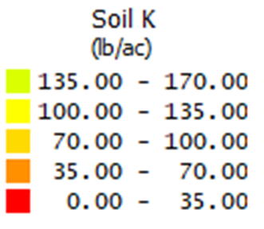
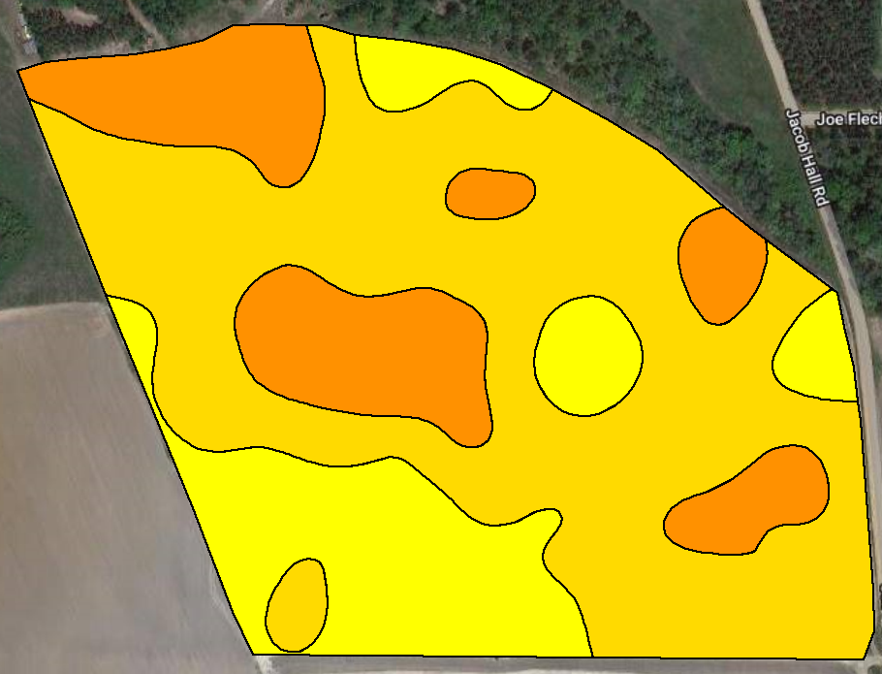
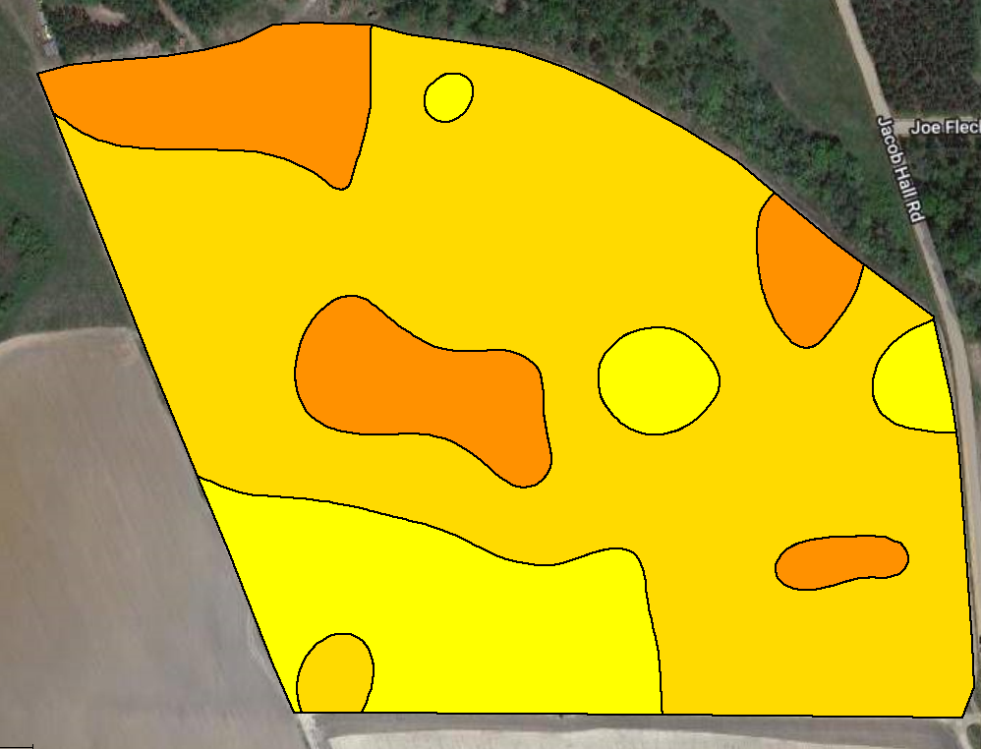
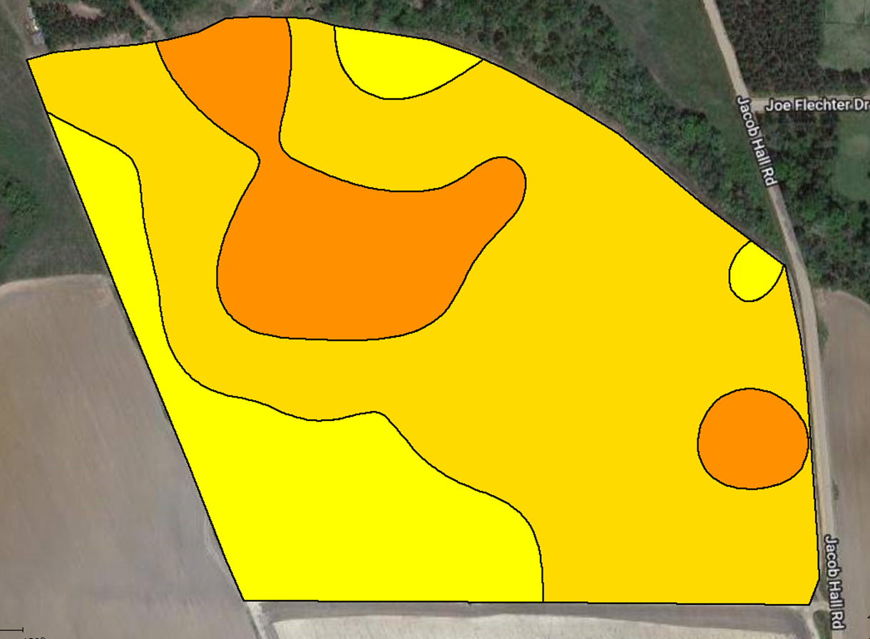
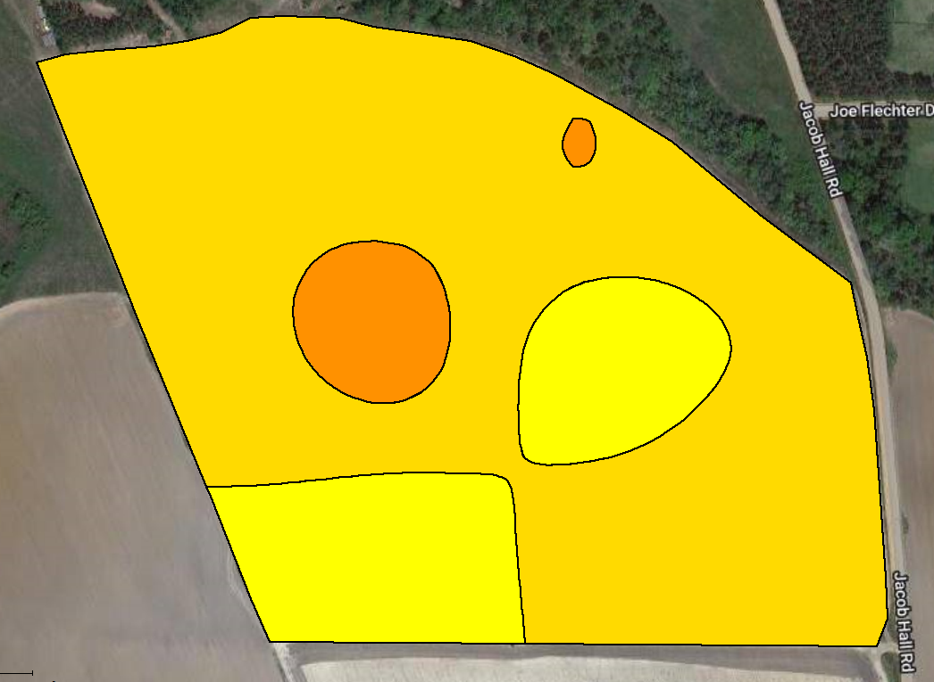
1 ac
(53 samples)
All samples Soil K Variability
(100 samples)
5 ac
(10 samples)
2.5 ac
(23 samples)

Slide 11
Economic Analysis
Consultant/Soil Lab Fees:
Soil sampling/Labor = $4-6/ac
Sample analysis = $6/sample
Variable-Rate Prescription Maps:
Cotton Lint Yield Goal = 1200 lb/ac
2023 UGA Cotton Enterprise Budget:
Lime = $50/ton
Phosphorus = $0.67/lb
Potassium = $0.68/lb
Total Cost ($/ac)
Grid Size | Samples | Sampling Cost | Analysis Cost | Fertilizer Cost | Total Cost
(ha) | (#) | ($/ac) | ($/ac) | ($/ac) | ($/ac)
1.0 | 90 | 6 | 6 | 33 | 45
2.5 | 35 | 5 | 2 | 29 | 36
5.0 | 17 | 4 | 1 | 26 | 31
7.5 | 13 | 4 | 1 | 28 | 33
10.0 | 8 | 4 | 1 | 37 | 41
=
Soil Sampling Cost ($/ac)
+
Soil Analysis Cost ($/ac)
+
Fertilizer Cost ($/ac)

Slide 12
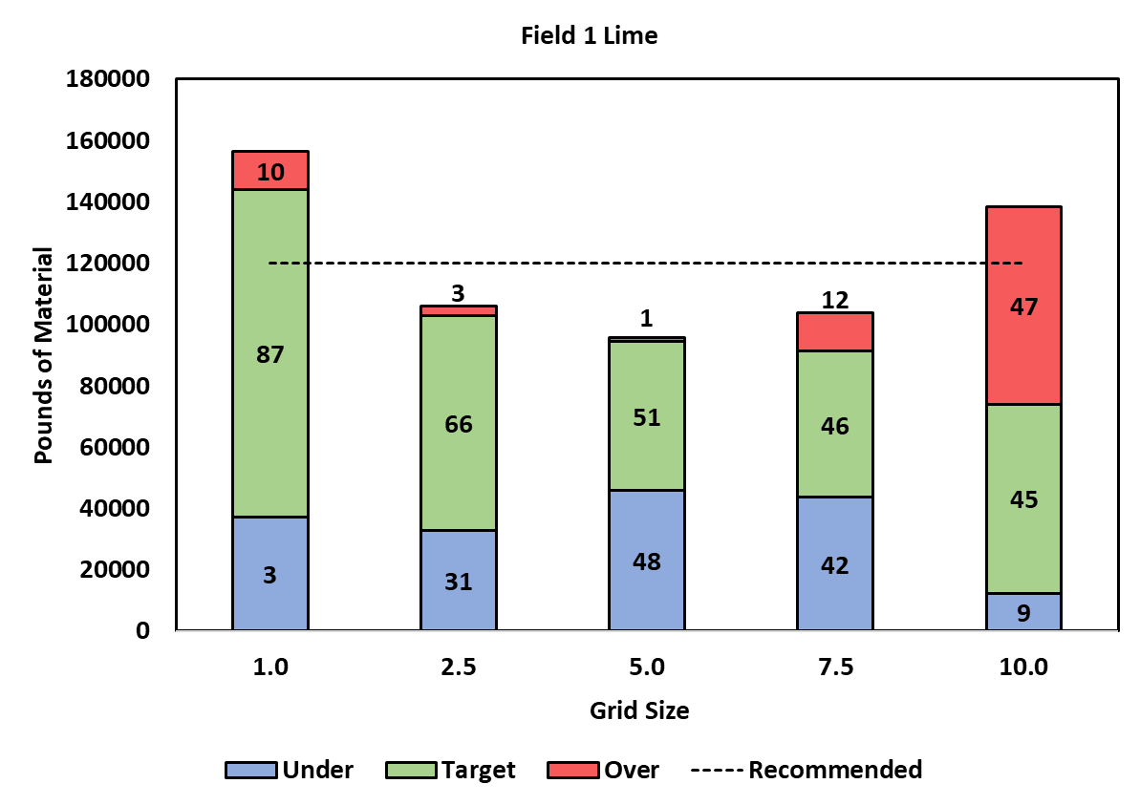
Application Accuracy and Cost
Field 1 - Lime
Grid Size | Analysis Cost | Lime Cost | Total Cost
(ac) | ($/ac) | ($/ac) | ($/ac)
1.0 | 10 | 33 | 43
2.5 | 6 | 29 | 35
5.0 | 5 | 26 | 31
7.5 | 5 | 28 | 33
10.0 | 5 | 37 | 41
*Sampling cost ($4-6/ac) was constant among all grid sizes.

Slide 13
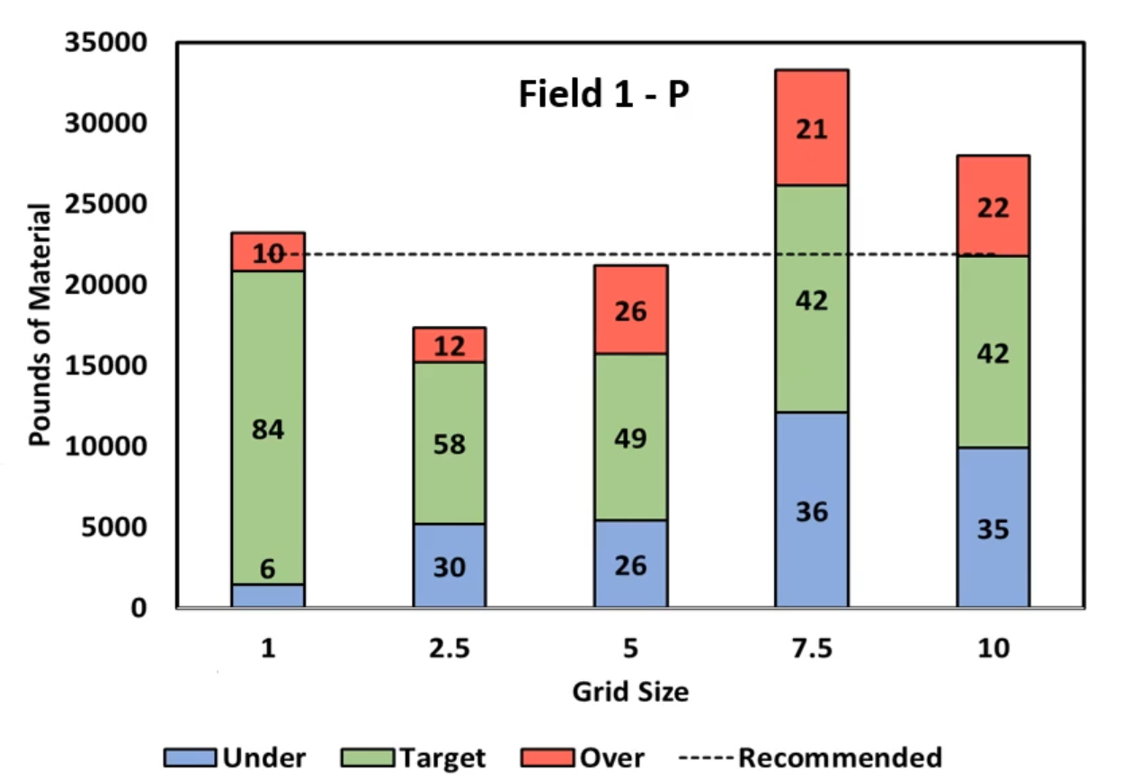
Application Accuracy and Cost
Field 1 - P

Slide 14
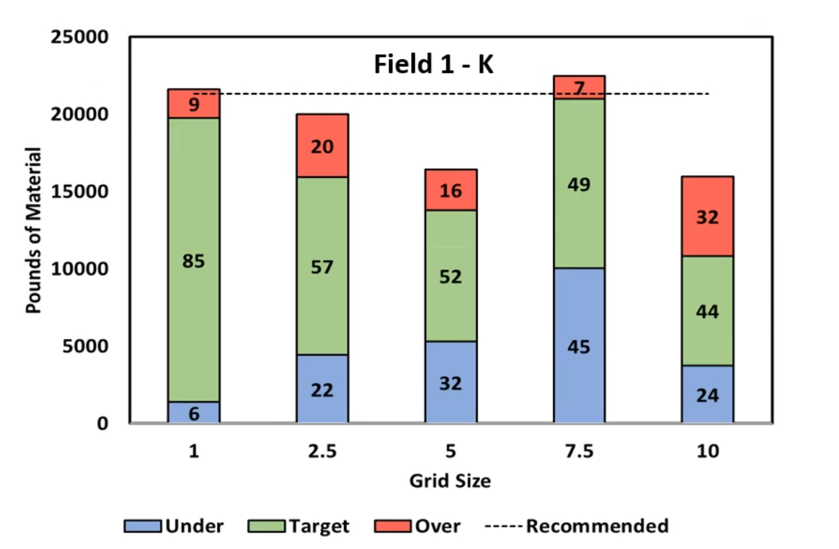
Application Accuracy and Cost

Slide 15
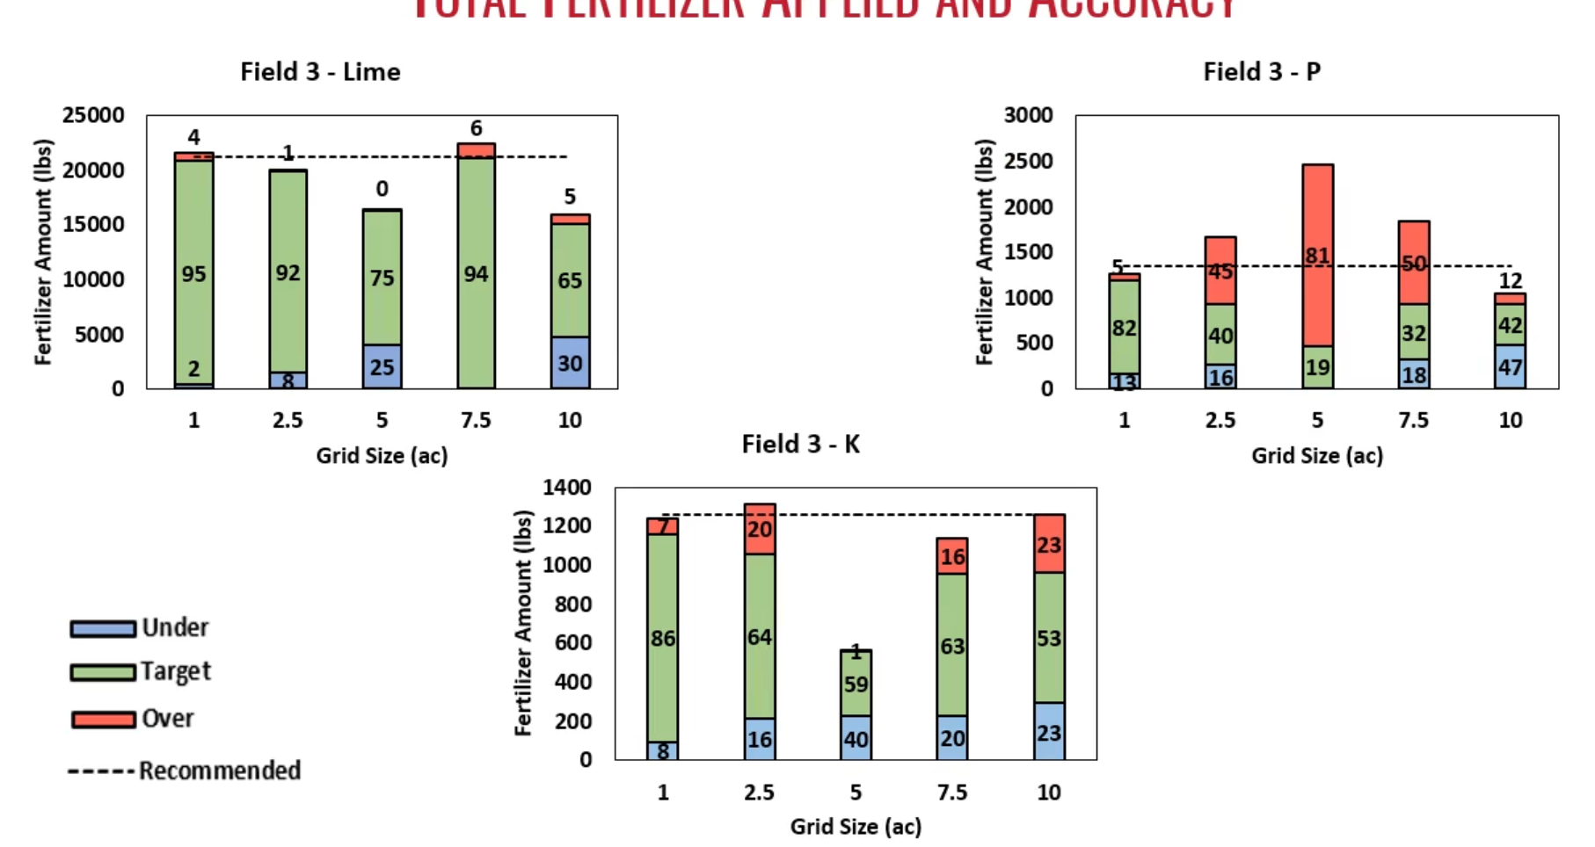
Total Fertilizer and Accuracy

Slide 16
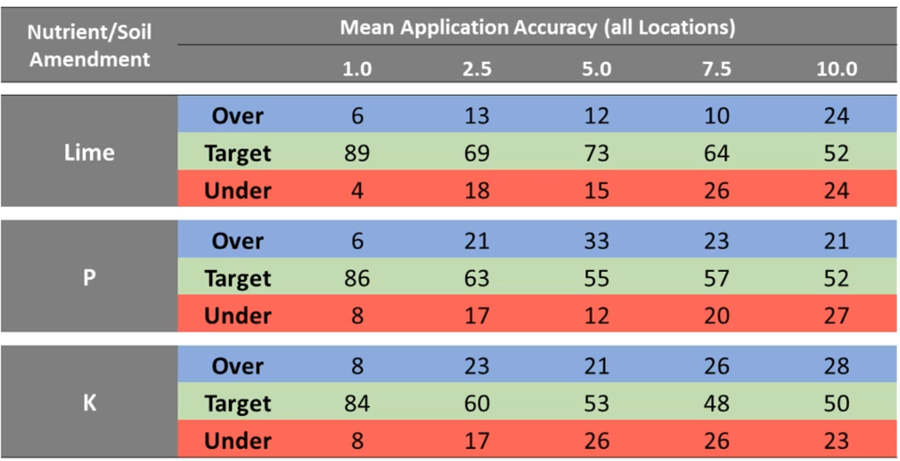
Application Accuracy

Slide 17
Grid Size – Effectiveness vs Cost
Lime, Potassium and Phosphorus
Application Accuracy (%)
Grid Size | F1 | F2 | F3 | F4 | F5 | F6 | F7 | F8 | F9
1.0 | 87 | 89 | 95 | 90 | 95 | 75 | 91 | 90 | 91
2.5 | 66 | 85 | 92 | 78 | 93 | 82 | 41 | 70 | 13
5.0 | 51 | 75 | 75 | 81 | 87 | 80 | 68 | 65 | 77
7.5 | 46 | 66 | 94 | 11 | 92 | 75 | 41 | 70 | 81
10.0 | 45 | 34 | 65 | 54 | 30 | 75 | 41 | 48 | 76
Application Costs ($/ac)
Grid Size | F1 | F2 | F3 | F4 | F5 | F6 | F7 | F8 | F9
1.0 | 43 | 20 | 34 | 33 | 34 | 43 | 40 | 38 | 56
2.5 | 35 | 14 | 28 | 27 | 30 | 41 | 31 | 33 | 64
5.0 | 31 | 15 | 23 | 26 | 32 | 41 | 35 | 36 | 55
7.5 | 33 | 20 | 30 | 5 | 30 | 42 | 30 | 31 | 51
10.0 | 41 | 17 | 22 | 18 | 39 | 42 | 30 | 22 | 55

Slide 18
Field 1
Lime
P
K
Grid Size | Accuracy (%) | Cost ($/ac)
1.0 | 89 | 20
2.5 | 85 | 14
5.0 | 75 | 15
7.5 | 66 | 20
10.0 | 34 | 17
Grid Size | Accuracy (%) | Cost ($/ac)
1.0 | 92 | 16
2.5 | 82 | 15
5.0 | 70 | 13
7.5 | 74 | 14
10.0 | 77 | 10
Grid Size | Accuracy (%) | Cost ($/ac)
1.0 | 88 | 89
2.5 | 72 | 85
5.0 | 66 | 82
7.5 | 49 | 86
10.0 | 44 | 86

Slide 19
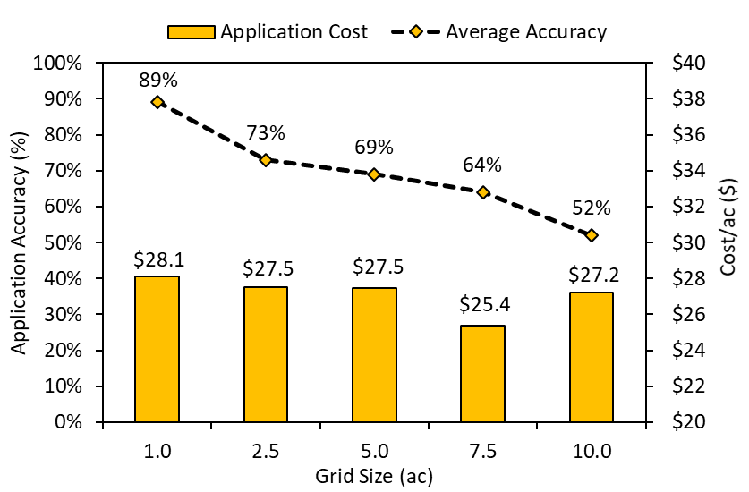
Lime

Slide 20
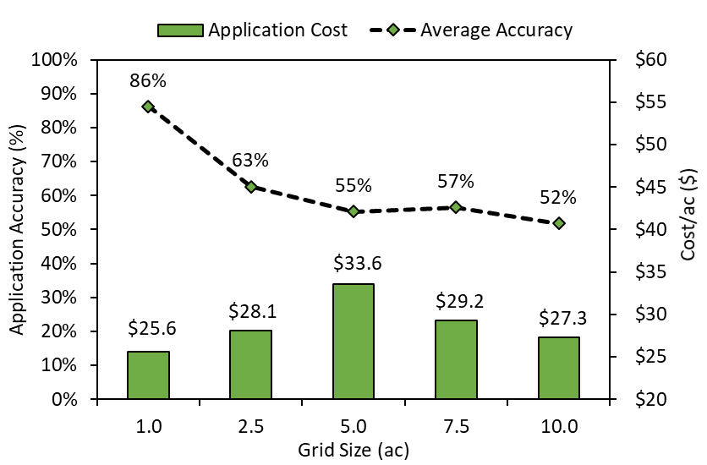
Phosphorus

Slide 21
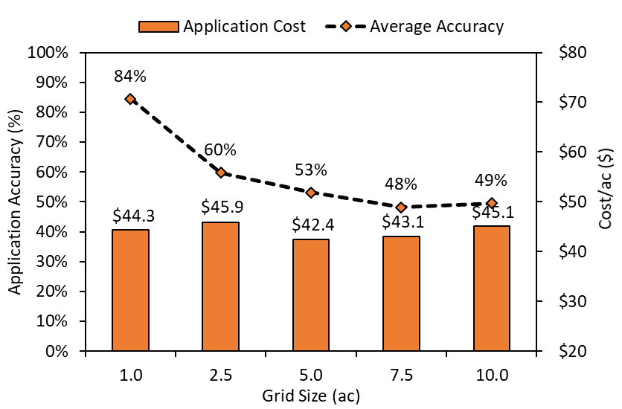
Potassium

Slide 22
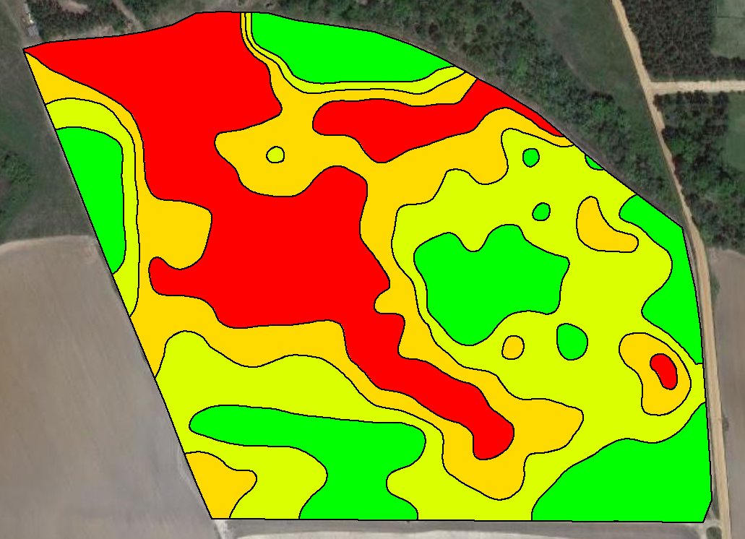
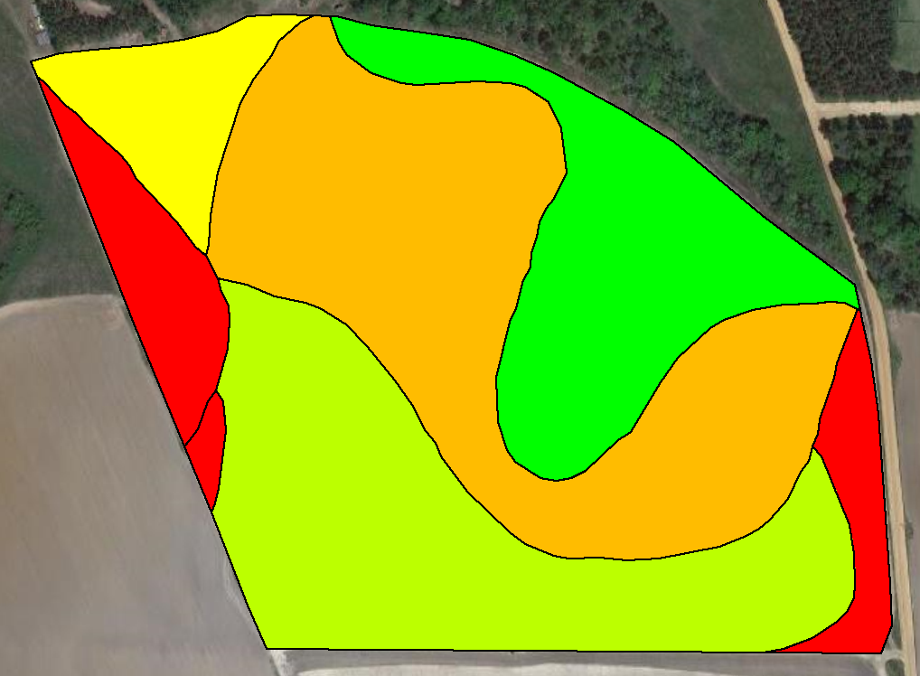
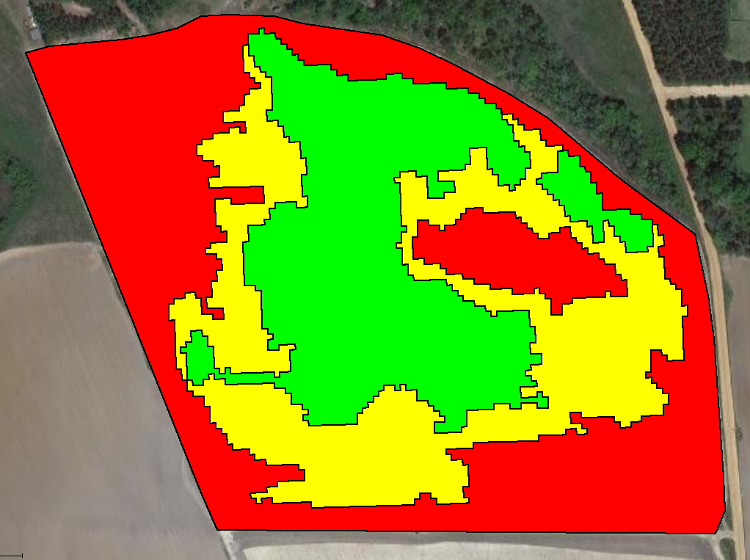
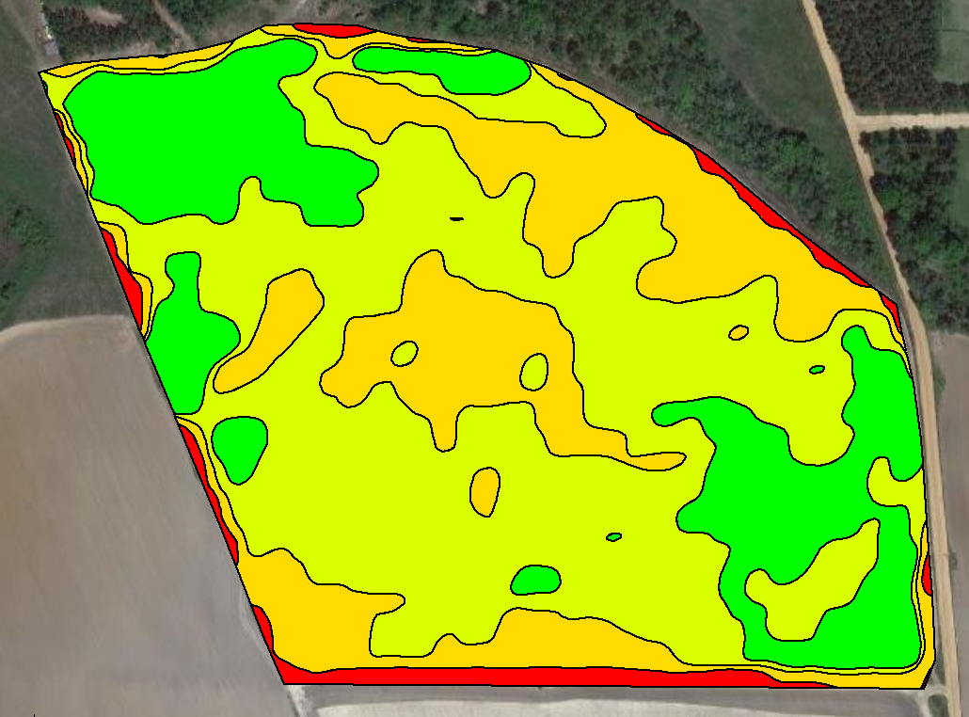
Zone Sampling
(Management Zones for Soil Sampling)
Soil EC (4 zones)
Soil Type (5 zones)
In-Season Crop Imagery/NDVI
(3 zones)
Soil Color/Brightness
(3 zones)

Slide 23

Zone-Based Soil Sampling
5 Zones = 5 Soil Samples (composite for each zone)
Each zone = 10 – 12 soil cores mixed together to make a composite sample
Soil Sampling/labor costs - $8-10/ac (expertise to create zones)

Slide 24
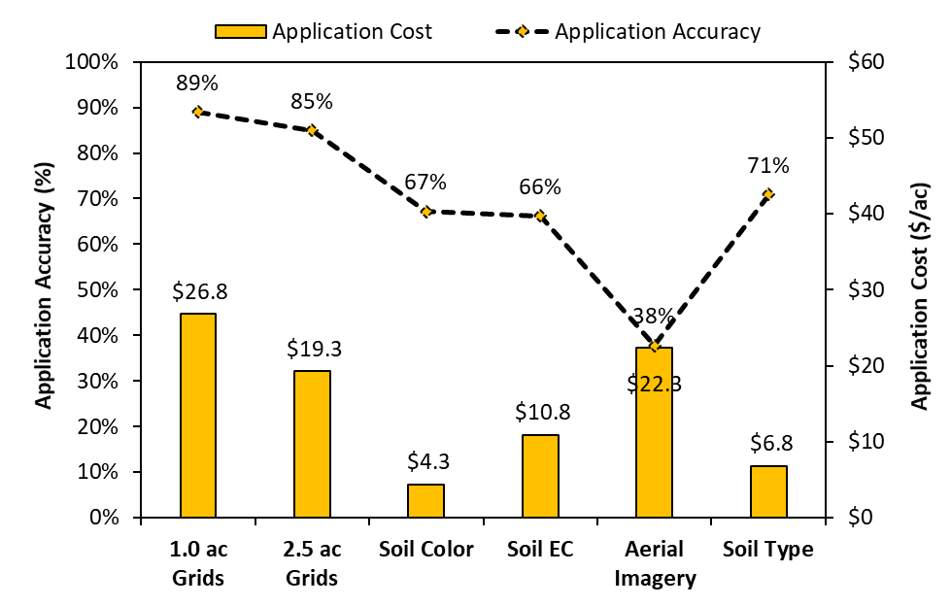
Lime
(53) (23) (3) (4) (3) (3)

Slide 25
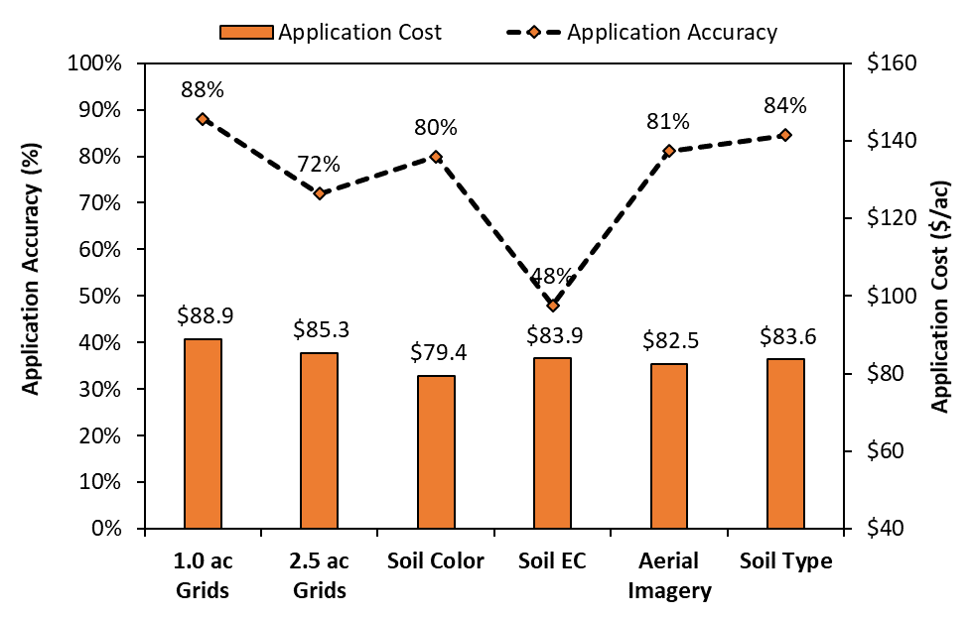
Potassium

Slide 26
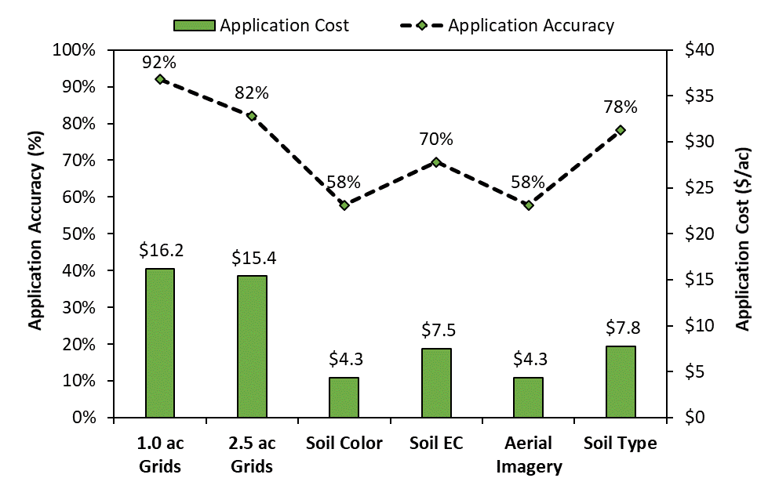
Phosphorus

Slide 27
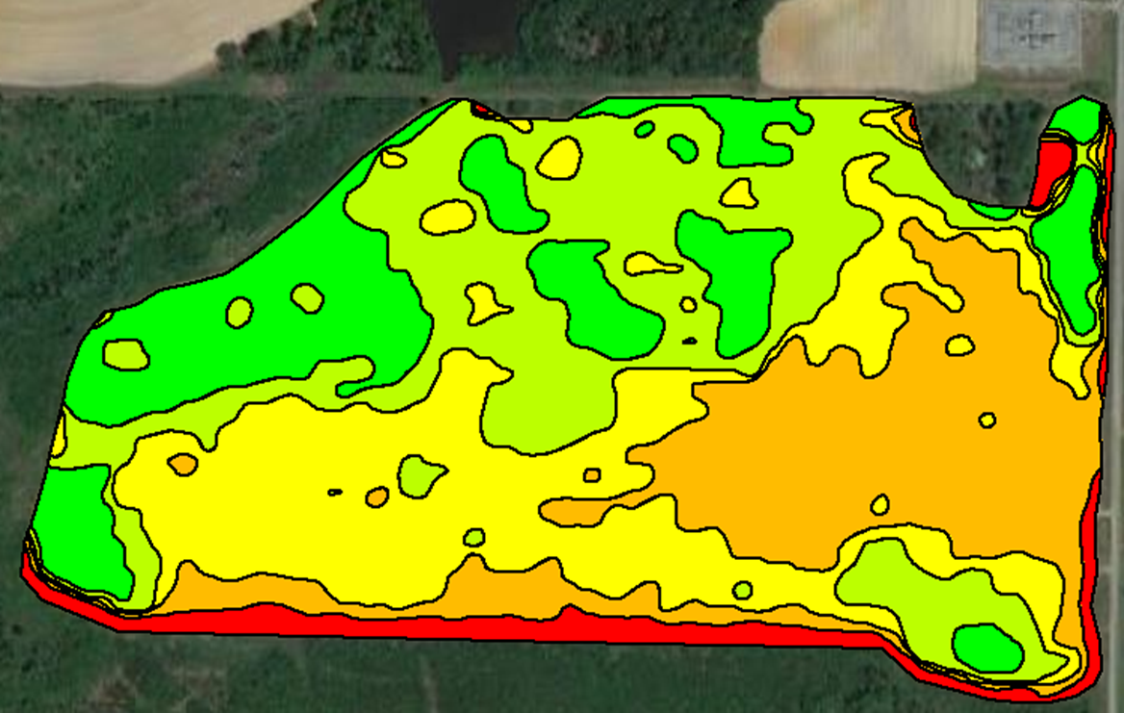
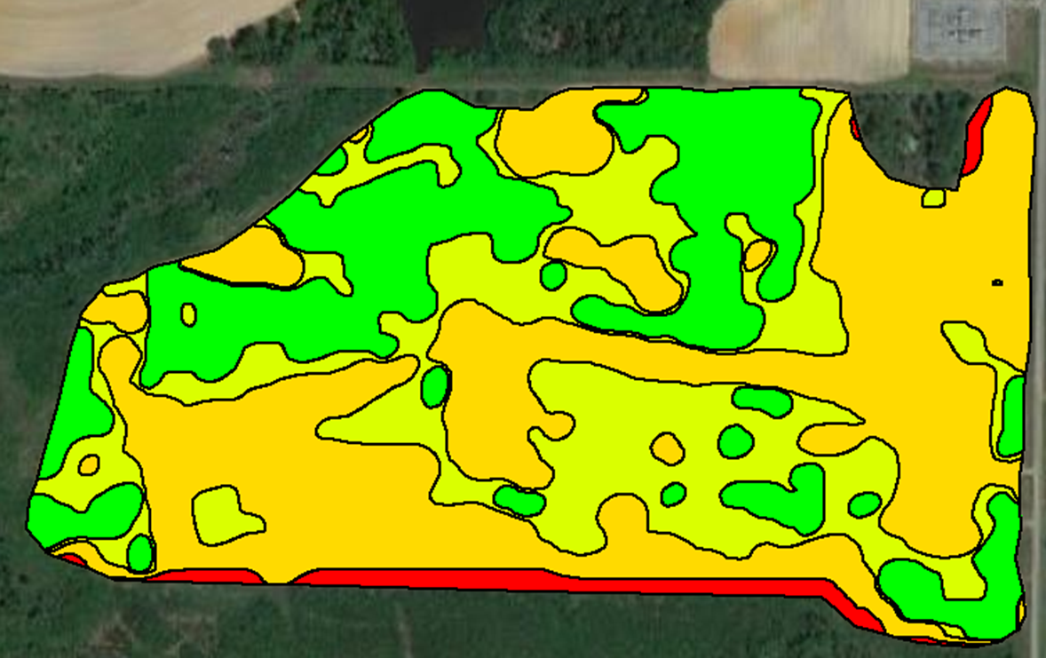
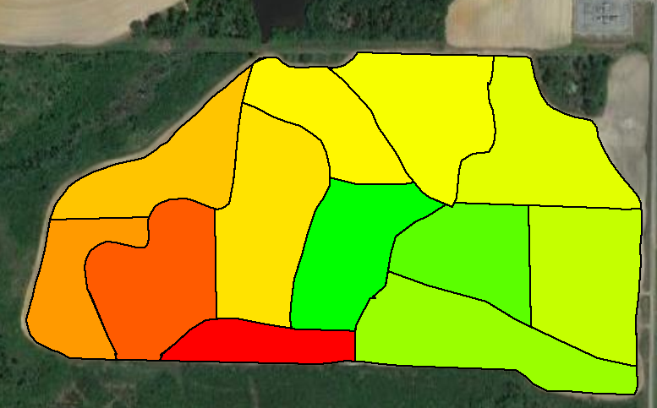
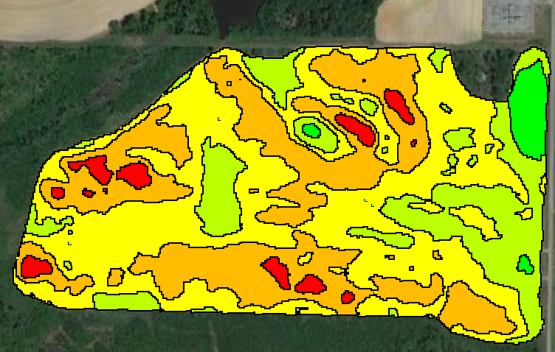
Zone Sampling – Field 2
Soil Color/Brightness (5 samples)
Soil EC (4 samples)
Field Knowledge and Yield (12 samples)
Soil Color and Elevation (5 samples)

Slide 28
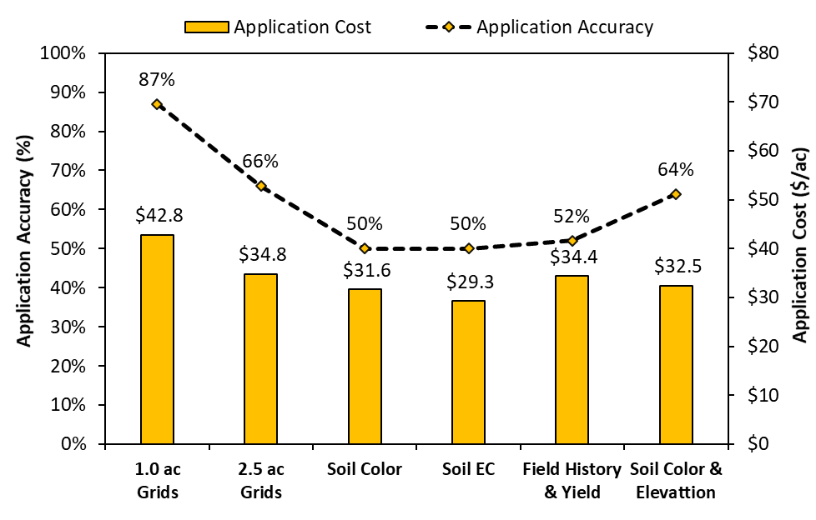
Lime
(90) (35) (5) (4) (12) (5)

Slide 29
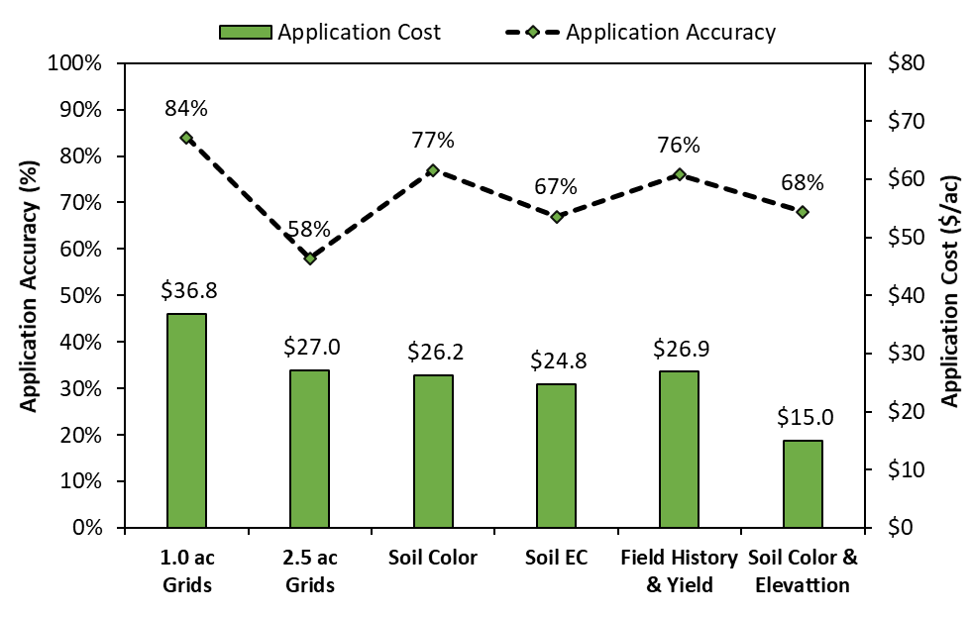
Phosphorus

Slide 30
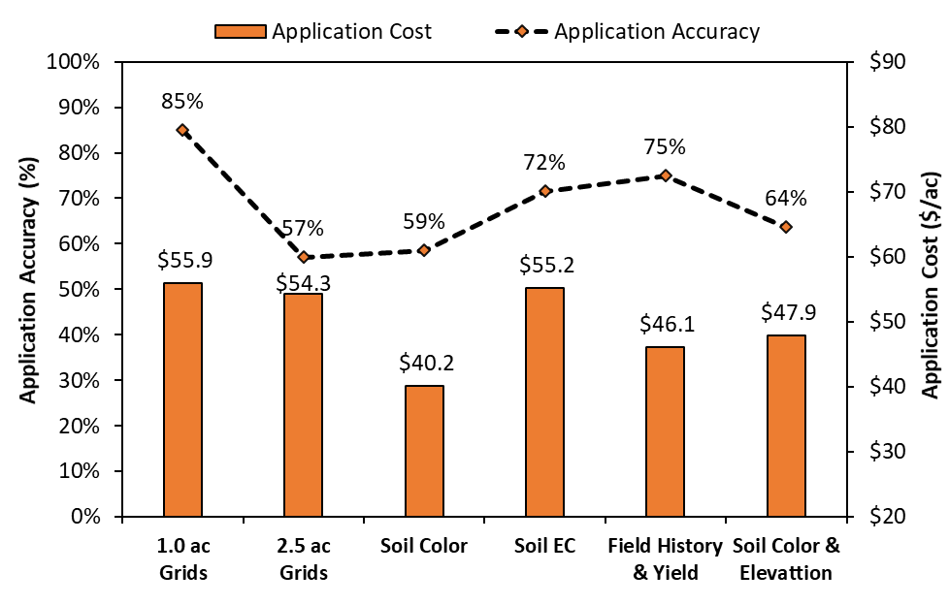
Potassium

Slide 31
Precision Soil Sampling Considerations
Grid sampling – grid size should not be greater than 2.5 ac. All new and existing fields should be sampled at least once on 1-ac to understand variability.
Zone sampling – keep it simple and practical. Incorporate important data layers (e.g. field knowledge/history) to refine management zones.
Grid vs Zone – start with grid sampling and gradually transition to zone sampling to be efficient with site-specific nutrient management and cost-effective.

Slide 32



Thanks!

Slide 33
Grid Size – Application Accuracy vs Cost
Field 1
Field 2
Field 3
Grid Size | Accuracy (%) | Cost ($/ac)
1.0 | 89 | 20
2.5 | 85 | 14
5.0 | 75 | 15
7.5 | 66 | 20
10.0 | 34 | 17
Grid Size | Accuracy (%) | Cost ($/ac)
1.0 | 87 | 43
2.5 | 66 | 35
5.0 | 51 | 31
7.5 | 46 | 33
10.0 | 45 | 41
Grid Size | Accuracy (%) | Cost ($/ac)
1.0 | 95 | 34
2.5 | 93 | 30
5.0 | 87 | 32
7.5 | 62 | 30
10.0 | 30 | 39

Slide 34
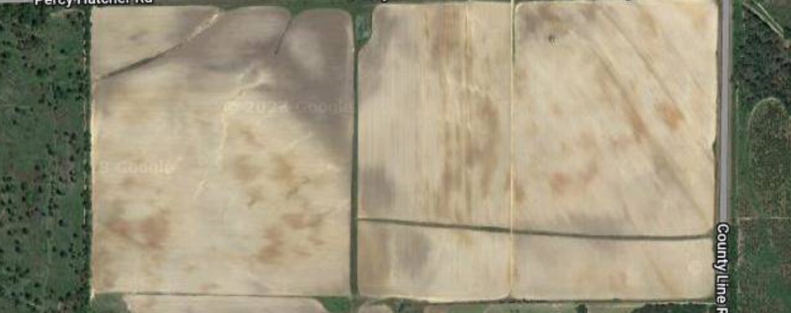

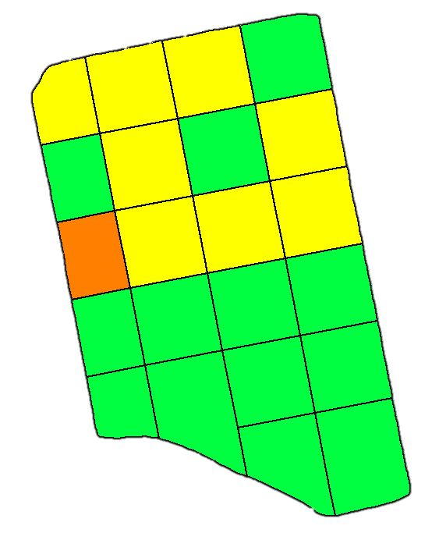
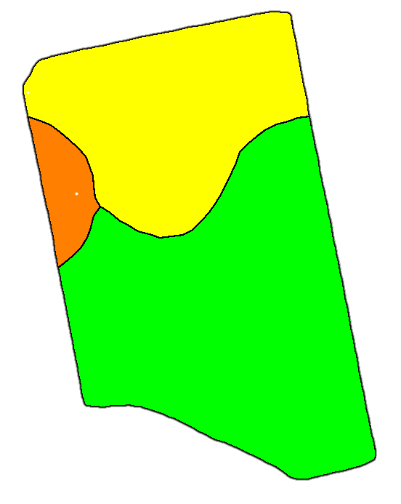
Precision Soil Sampling Strategies
Traditional Soil Sampling
(1-2 composite sample)
Grid Soil Sampling
( uniform sized grids)
Zone Soil Sampling
(zones based on certain soil/crop properties)

Slide 35
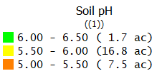



Lime
N-P-K (30-0-110 lbs)
Uniform Application – 26 ton - $1,300
Variable-Rate Application – 14 ton - $700
Uniform Application – 2,860 lbs - $3,224
Variable-Rate Application – 2,180 lbs - $2,566
$23/acre
$25/acre

